Slide 1
Social Scientific Values MOT1442 Q2
Dr Jack Casey

Slide 2
Overview
Last week we looked at an overview of philosophy of science
Reasoning is core to science and philosophy
This week, we’re looking at reasoning in formal argumentation

Slide 3
Arguments
When we talk about reasoning, we’re talking about arguments
Arguments are used to extend our knowledge
They are the bridge between beliefs already justified and novel ones
How do we know when they’re good or bad?
This is our core question, today

Slide 4
Structure of the lecture
First half:
Informal Fallacies
Formal logic 1
Second half:
Formal logic 2
Formal Fallacies
Note: these lecture slides are quite detailed, you might want to download them from Brightspace to follow along!

Slide 5
Problems with Arguments
When arguments are bad, it’s usually because they employ some form of fallacy.
Fallacies can be either informal or formal.
Informal fallacies are characterised by an error in the content of an argument.
Formal fallacies are characterised by an error in the structure of an argument.

Slide 6
Informal Fallacies
These are the most common types of errors.
The error is contentful
For example, ad hominem is an informal fallacy.
Latin for ‘against the person’
Here’s an example of an ad hominem argument:
P1. Fred says the bar is open
P2. But Fred likes to drink, so he would say that
C. The bar isn’t really open

Slide 7
Informal Fallacies – Ad Hominem
P1. Fred says the bar is open
P2. But Fred likes to drink, so he would say that
C. The bar isn’t really open
The proposition (‘the bar is open’) isn’t the target
Instead, Fred is the target.
P2’s function: Fred is unreliable, therefore what Fred says is false.
This, however, isn’t a reliable inference (unreliable people say true things from time to time!)
When the target of an argument is the speaker and not the content, the ad hominem fallacy is usually being employed

Slide 8
Informal Fallacies – Other Examples
More examples of informal fallacies:
Appeal to nature (covered last week)
Naturalistic fallacy
Post hoc ergo propter hoc
Appeal to the law
Appeal to ignorance
Begging the question

Slide 9
Informal Fallacies – Other Examples
Naturalistic Fallacy
Important to note: Different from appeal to nature
Concerns the descriptive/normative distinction
Moving from descriptive claims, to normative claims
We can’t infer what should be the case, from what is the case (or vice versa)
Example:
Premise: People need to drink 5 glasses of water a day, and eat plenty of vegetables to be healthy
Conclusion: I should drink 5 glasses of water a day, and eat plenty of vegetables

Slide 10
Informal Fallacies – Other Examples
Post hoc ergo propter hoc
Latin: ‘after this, therefore because of this’
‘Because x followed y, x must have been caused by y’
Correlation does not imply causation
Example:
Premise: I felt sick after I ate all that food last night
Conclusion: The food must have made me feel ill
Premise: Every time I go to the doctor, I get a bad diagnosis
Conclusion: I should stop going to the doctor

Slide 11
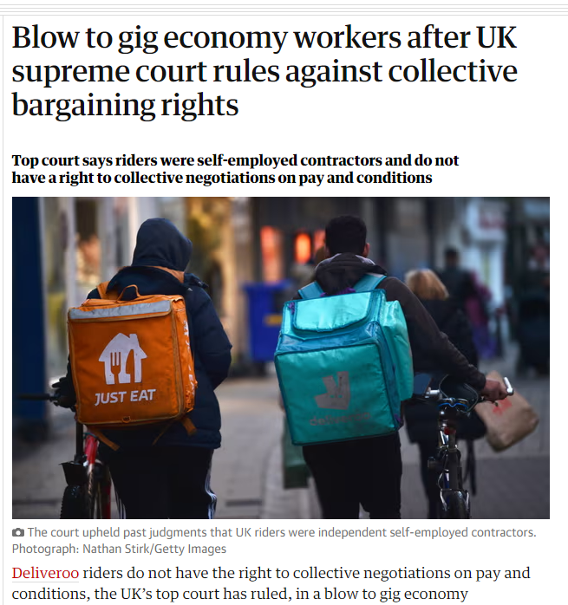
Informal Fallacies – Other Examples
Appeal to the law
Conflates illegality with immorality
Just because an act is illegal, doesn’t imply necessarily that that act is immoral (or vice versa)
Examples:
The court says it’s legal to not pay your workers, therefore employers have no moral duty to look after them.
Murder is illegal. Taking drugs is illegal. Murder is morally wrong, and therefore so is taking drugs.

Slide 12
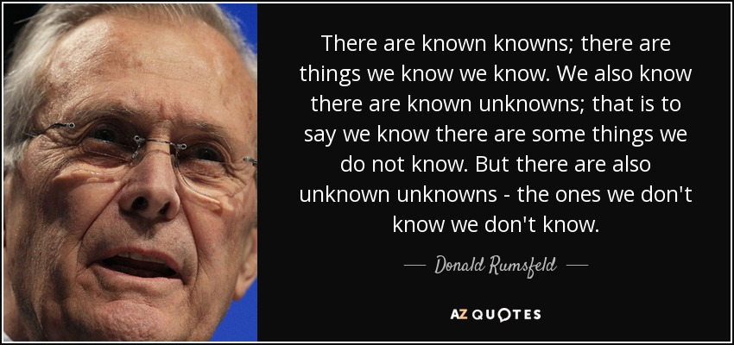
Informal Fallacies – Other Examples
Appeal to ignorance
Concluding that a proposition is true because there is no evidence against it
We have no evidence that aliens don’t exist, therefore, they do
We have no long-term evidence that vaccines are safe, therefore they are dangerous
US defense secretary Donald Rumsfeld, lead up to the Iraq War, in reference to WMDs (2002):
‘Simply because you do not have evidence that something exists does not mean that you have evidence that it doesn't exist’

Slide 13
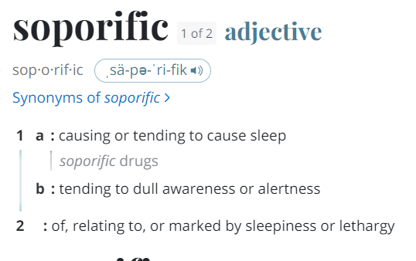
Informal Fallacies – Other Examples
Begging the question
Technical term – different from common usage
To assume the truth of your conclusion in the premises
Examples:
‘I’m in charge because what I say goes!’
‘Opium induces sleep because it has soporific qualities’
‘Multiculturalism will not work because different cultures cannot coexist’

Slide 14
Informal Fallacies
There are numerous informal fallacies, and countless examples of them
Depend on the content of the argument
Require you to look at the argument content to detect their presence

Slide 15
Formal Fallacies – first thing’s first
There is another way of detecting faults with arguments, however
This method only requires we look at the structure of an argument
Before we look at these fallacies, we first need a methodology for analysing this structure

Slide 16
Arguments - Reminder
Take our example from last week, once more:
Premise 1. If today is Thursday, then tomorrow it will be Friday.
Premise 2. Today is Thursday.
Conclusion. Tomorrow, it will be Friday

Slide 17
Arguments - Reminder
This argument is valid. An argument is valid if and only if the truth of the premises entail the truth of the conclusion. What that means is, if the premises are true, the conclusion must be true.
Premise 1. If today is Thursday, then tomorrow it will be Friday.
Premise 2. Today is Thursday.
Conclusion. Tomorrow, it will be Friday

Slide 18
Arguments - Validity
An argument can still be valid, even if the premises are actually false.
As long as it’s the case that, if they are true, the conclusion would have to be true, then the argument is valid.
Premise 1. If today is Wednesday, then tomorrow it will be Thursday.
Premise 2. Today is Wednesday.
Conclusion. Tomorrow, it will be Thursday.

Slide 19
Arguments - Validity
When an argument is valid, and the premises are true, the argument is sound.
Premise 1: If today is Thursday, then tomorrow is Friday.
Premise 2: Today is Thursday.
Conclusion: Tomorrow is Friday.

Slide 20
Arguments – Translating sentences
First of all, we translate the sentences of an argument into symbolic form. We’ll let the letters p and q stand for whole sentences.
So, to take our earlier example:
P1. If today is Thursday, then tomorrow is Friday
P2. Today is Thursday
C. Tomorrow is Friday
We’ll translate this to:
P1. If p, then q
P2. p
C. q

Slide 21
Arguments – Logical Connectives
There were some extra parts we didn’t translate (namely, the if… then… part).
We then have to translate the connectives (i.e., the parts that connect sentences in arguments).
There are 5 logical connectives in propositional logic. These translate as follows:
P1. If p, then q
P2. p
C. q
English connective | Logical connective
P or Q | P ∨ Q
P and Q | P ∧ Q
If P then Q | P → Q
P, if and only if Q | P ⟷ Q
Not-P | ¬P

Slide 22
Arguments – Logical Connectives
So, to translate our earlier example:
P1. If p, then q
P2. p
C. q
This becomes:
P1. p → q
P2. p
C. q
English connective | Logical connective
P or Q | P ∨ Q
P and Q | P ∧ Q
If P then Q | P → Q
P, if and only if Q | P ⟷ Q
Not-P | ¬P

Slide 23
Arguments – Logical Connectives
So, to translate our earlier example:
P1. If p, then q
P2. p
C. q
This becomes:
P1. p → q
P2. p
C. q
English connective | Logical connective
P or Q | P ∨ Q
P and Q | P ∧ Q
If P then Q | P → Q
P, if and only if Q | P ⟷ Q
Not-P | ¬P

Slide 24
Arguments – Logical Connectives
Let's translate another, more complicated example:
P1. If it’s raining, then I’m not happy.
P2. It’s raining, and I’m wearing a raincoat.
C. I’m not happy.
English connective | Logical connective
P or Q | P ∨ Q
P and Q | P ∧ Q
If P then Q | P → Q
P, if and only if Q | P ⟷ Q
Not-P | ¬P

Slide 25
Arguments – Logical Connectives
First of all, substitute sentences for letters:
P1. If it’s raining, then I’m not happy.
P2. It’s raining, and I’m wearing a raincoat.
C. I’m not happy.
Becomes:
P1. If p, then not-q
P2. p and r
C. not-q
English connective | Logical connective
P or Q | P ∨ Q
P and Q | P ∧ Q
If P then Q | P → Q
P, if and only if Q | P ⟷ Q
Not-P | ¬P

Slide 26
Arguments – Logical Connectives
And now, substitute the English connectives for logical operators:
P1. If p, then not-q
P2. p and r
C. not-q
Becomes:
P1. p → ¬q
P2. p ∧ r
C. ¬q
Bonus: is this valid or invalid?
English connective | Logical connective
P or Q | P ∨ Q
P and Q | P ∧ Q
If P then Q | P → Q
P, if and only if Q | P ⟷ Q
Not-P | ¬P

Slide 27
Arguments - Validity
English connective | Logical connective
P or Q | P ∨ Q
P and Q | P ∧ Q
If P then Q | P → Q
P, if and only if Q | P ⟷ Q
Not-P | ¬P
We have to give meaning to the logical connectives.
We give them meaning, in propositional logic, by giving their truth conditions.

Slide 28
Arguments - Validity
So, let's take ‘and’, as an example. Under what conditions is the sentence ‘p and q’ (‘p ∧ q’) true?
If I said, ‘it’s raining and it’s cold’, the sentence is only true when it’s both raining, and it’s cold.
The sentence ‘it’s raining and it’s cold’ isn’t true when only one of the two conjuncts (i.e., p, q) are true.
Equally, ‘it’s raining and it’s cold’ isn’t true when neither of them are true.

Slide 29
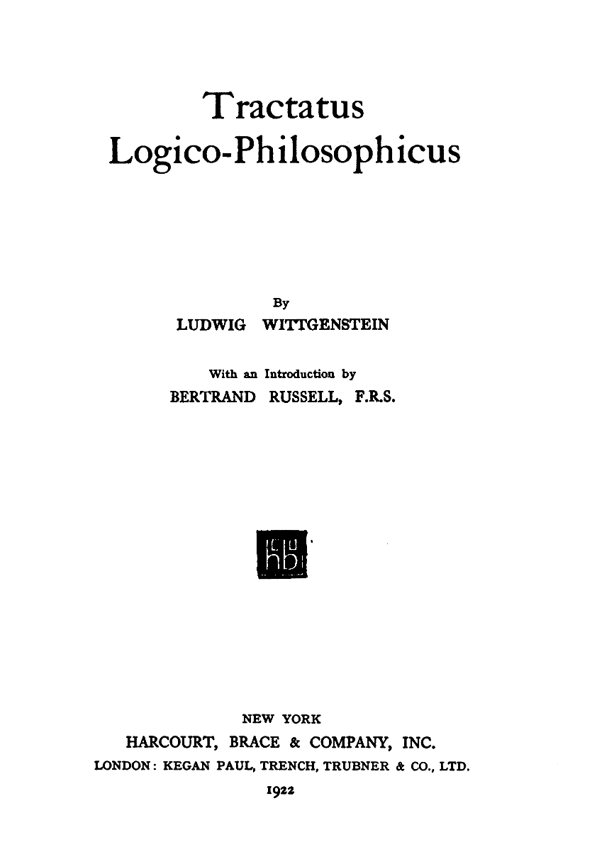
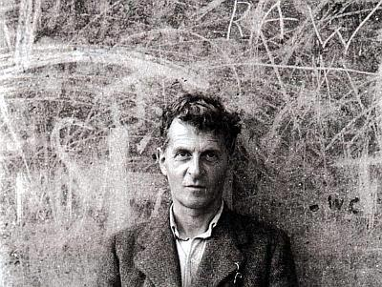
Arguments – Truth Tables
We can do this more rigorously using a truth table.
A truth table exhaustively describes the conditions under which the sentence could be true or false.

Slide 30
Arguments – Truth Tables
Once again, take our example: ‘it’s raining and it’s cold’.
Substitute ‘it’s raining’ for P, and ‘it’s cold’ for ‘Q’
There are a total of four combinations of how the world might be here, given either the truth or falsity of both P and Q.
It could be that:
P is true, and Q is true (it’s raining, and it’s cold’)
P is true, and Q is false (it’s raining but it’s not cold)
P is false, and Q is true (it’s not raining but it’s cold)
P is false, and Q is false (it’s not raining and it’s not cold)

Slide 31
Arguments – Truth Tables
We’ll symbolise true as 1, and false as 0.
P is true, and Q is true
P is true, and Q is false
P is false, and Q is true
P is false, and Q is false
Putting our earlier possible combinations in a table, we get this:
P (‘it’s raining’) | Q (‘it’s cold’)
1 | 1
1 | 0
0 | 1
0 | 0

Slide 32
Arguments – Truth Tables (Conjunction)
Now, we can define our connective ‘and’(also known as conjunction) by saying when the sentence ‘P and Q’ is true or false in each of these possible combinations:
P (‘it’s raining’) | Q (‘it’s cold’) | P ∧ Q (it’s raining and it’s cold’)
1 | 1 | 1
1 | 0 | 0
0 | 1 | 0
0 | 0 | 0

Slide 33
Arguments – Truth Tables (Conjunction)
Notice, it’s only when P and Q are both true, that the sentence ‘P ∧ Q’ is true.
This is exactly how we want it. As we said, it’s only when both ‘P’ is true and ‘Q’ is true, that ‘P ∧ Q’ was true.
P | Q | P ∧ Q
1 | 1 | 1 (true)
1 | 0 | 0 (false)
0 | 1 | 0 (false)
0 | 0 | 0 (false)

Slide 34
Arguments – Truth Tables (Disjunction)
And we can expand this for the other 4 operators. So, let’s do the truth table for ‘or’ (also known as disjunction):
P | Q | P ∧ Q | P ∨ Q
1 | 1 | 1 | 1
1 | 0 | 0 | 1
0 | 1 | 0 | 1
0 | 0 | 0 | 0

Slide 35
Arguments – Truth Tables (Disjunction)
This one is a little trickier. Usually, in English, we use the exclusive ‘or’.
For example, if I say, ‘I have an apple, or I have a banana’, we don’t think the sentence is true if I have both an apple and a banana.
In propositional logic, however, we treat ‘or’ as inclusive, so if I said ‘I have an apple, or I have a banana’, and I have both an apple and a banana, then the sentence is true, when translated.
P ‘I have an apple’ | Q ‘I have a banana’ | P ∧ Q ‘I have an apple and a banana’ | P ∨ Q ‘I have an apple or a banana’
1 | 1 | 1 | 1
1 | 0 | 0 | 1
0 | 1 | 0 | 1
0 | 0 | 0 | 0
This is the circumstance in which I have both an apple and a banana.

Slide 36
Arguments – Truth Tables (Disjunction)
Nonetheless, the other three results are quite straightforward. If I have either an apple, or I have a banana, then P v Q is true. It’s only in circumstances where I have neither that the sentence is false (i.e., the bottom line).
P | Q | P ∧ Q | P ∨ Q
1 | 1 | 1 | 1
1 | 0 | 0 | 1
0 | 1 | 0 | 1
0 | 0 | 0 | 0
This is the circumstance in which I have neither an apple nor a banana.

Slide 37
Arguments – Truth Tables (Material Conditional)
There’s three more connectives to go. First of all, there’s the ‘if… then…’ connective (also known as the material conditional). The truth table for the material conditional is as follows:
P | Q | P ∧ Q | P ∨ Q | P → Q
1 | 1 | 1 | 1 | 1
1 | 0 | 0 | 1 | 0
0 | 1 | 0 | 1 | 1
0 | 0 | 0 | 0 | 1

Slide 38
Arguments – Truth Tables (Material Conditional)
The material conditional turns out as true in all circumstances except those in which the antecedent (the ‘P’ in ‘P → Q’) is true, but the consequent (the ‘Q’ in ‘P → Q’) is false.
P | Q | P ∧ Q | P ∨ Q | P → Q
1 | 1 | 1 | 1 | 1
1 | 0 | 0 | 1 | 0
0 | 1 | 0 | 1 | 1
0 | 0 | 0 | 0 | 1

Slide 39
Arguments – Truth Tables (Material Conditional)
This is potentially the most counterintuitive truth table you’ll meet.
If we swap P and Q for actual sentences, it makes it easier to test whether the sentence aligns with our intuition.
Let P stand for ‘it rains’, and Q stand for ‘the floor gets wet’.
(Situation 1) The first line makes intuitive sense. ‘If it rains then the floor gets wet’ is true when it’s true that it’s raining, and the floor is indeed wet.
(Situation 2) Similarly, it’s intuitively sensible that ‘If it rains then the floor gets wet’ is false when it rains, but the floor isn’t wet.
P | Q | P ∧ Q | P ∨ Q | P → Q
1 | 1 | 1 | 1 | 1
1 | 0 | 0 | 1 | 0
0 | 1 | 0 | 1 | 1
0 | 0 | 0 | 0 | 1
Situation 1
Situation 2

Slide 40
Arguments – Truth Tables (Material Conditional)
However, this is where things start to make less sense.
According to our truth table, the sentence ‘if it rains, then the floor gets wet’ is true when it doesn’t rain, and the floor is indeed wet. (i.e., situation 3)
Similarly, according to the truth table, ‘if it rains, then the floor gets wet’ is true when it doesn’t rain, and the floor isn’t wet. (i.e., situation 4)
P | Q | P ∧ Q | P ∨ Q | P → Q
1 | 1 | 1 | 1 | 1
1 | 0 | 0 | 1 | 0
0 | 1 | 0 | 1 | 1
0 | 0 | 0 | 0 | 1
Situation 3
Situation 4

Slide 41
Arguments – Truth Tables (Material Conditional)
We’ll go into why this is in more detail in the tutorials.
For now, the best way to think of it is this: the only circumstance in which ‘if it rains, then the floor gets wet’ is definitely false, is when it rains, and the floor isn’t wet (i.e., situation 2).
In a circumstance in which it doesn’t rain, we just don’t know whether the conditional ‘if it rains, then the floor gets wet’ is true; we haven’t tested it, so to speak.
Out logic is two-valued – things can be either true, or false. And if we can’t be sure it’s false, then it can only be the other option – true!
P | Q | P ∧ Q | P ∨ Q | P → Q
1 | 1 | 1 | 1 | 1
1 | 0 | 0 | 1 | 0
0 | 1 | 0 | 1 | 1
0 | 0 | 0 | 0 | 1
Situation 2

Slide 42
Arguments – Truth Tables (Biconditional)
Our penultimate operator is the biconditional, or the ‘if and only if’ (sometimes written ‘iff’).
Sentences with a biconditional are true when either 1) both P and Q are true (i.e., situation 1), or 2) when both P and Q are false (i.e., situation 2).
P | Q | P ∧ Q | P ∨ Q | P → Q | P⟷Q
1 | 1 | 1 | 1 | 1 | 1
1 | 0 | 0 | 1 | 0 | 0
0 | 1 | 0 | 1 | 1 | 0
0 | 0 | 0 | 0 | 1 | 1
Situation 1
Situation 2

Slide 43
Arguments – Truth Tables (Biconditional)
This makes intuitive sense, which we can see if we translate a biconditional into English.
So, take the sentence, ‘I’ll go to the party, if and only if you go too’.
In this circumstance, the sentence is true only 1) when both of us go (i.e., P and Q are true), or 2) when neither of us go (i.e., P and Q are false).
If only one of us goes to the party, then the sentence is false, and this is what the truth table says.
P | Q | P ∧ Q | P ∨ Q | P → Q | P⟷Q
1 | 1 | 1 | 1 | 1 | 1
1 | 0 | 0 | 1 | 0 | 0
0 | 1 | 0 | 1 | 1 | 0
0 | 0 | 0 | 0 | 1 | 1

Slide 44
Arguments – Truth Tables (Negation)
Our final operator, the ‘not’ operator (also known as negation) only operates on one letter, so it’s truth table is slightly different.
It’s also very simple; when P is false, the sentence ‘not-P’ is true. Similarly, when P is true, then the sentence ‘not-P’ is false.
Again, this is intuitive. The sentence ‘it’s not raining’ is false when it’s raining, and true when it is!
P | ¬P
1 | 0
0 | 1

Slide 45
Arguments – Truth Tables
Altogether then, our truth table looks like this.
These are the definitions of the logical operators; they fully define their meaning.
P | Q | P ∧ Q | P ∨ Q | P → Q | P⟷Q | ¬P
1 | 1 | 1 | 1 | 1 | 1 | 0
1 | 0 | 0 | 1 | 0 | 0 | 0
0 | 1 | 0 | 1 | 1 | 0 | 1
0 | 0 | 0 | 0 | 1 | 1 | 1

Slide 46
Arguments – Truth Tables
We can do truth tables for complex compound sentences with multiple connectives within them.
I’ll quickly demonstrate this now, but this is something we’ll do together in more detail in the tutorials as well.

Slide 47
Arguments – Truth Tables
So, for example, lets build the truth table for the sentence ‘P ∧ (P → Q)’

Slide 48
Arguments – Truth Tables
So, for example, lets build the truth table for the sentence:
‘P ∧ (P → Q)’
We always start by the full configuration of the possible combinations of the sentences that appear in the compound sentence (i.e., P and Q).
These never change. They only extend if you add in more atomic sentences
P | Q
1 | 1
1 | 0
0 | 1
0 | 0

Slide 49
Arguments – Truth Tables
Next, we’ll break the sentence down into its constituent parts. *Original sentence: ‘‘P ∧ (P → Q)’*
Sentences in brackets are always well-formed formulae (i.e., they can’t be broken down further)
Therefore, we know we’ll need a truth table for ‘(P → Q)’
This is the same as it appears on a normal truth table
P | Q |  | P → Q
1 | 1 |  | 1
1 | 0 |  | 0
0 | 1 |  | 1
0 | 0 |  | 1

Slide 50
Arguments – Truth Tables
Next, we have to add in the ‘P ∧ …’ portion of our compound sentence.
But what values do we enter here?
P | Q | P ∧ | P → Q
1 | 1 |  | 1
1 | 0 |  | 0
0 | 1 |  | 1
0 | 0 |  | 1

Slide 51
Arguments – Truth Tables
On our original truth table, we had the truth value for ‘P ∧ Q’, but now we have different values for the second conjunct.
Original Truth Table for Conjunction
Initial values for the second conjunct
P | Q | P ∧ Q
1 | 1 | 1
1 | 0 | 0
0 | 1 | 0
0 | 0 | 0
P | Q | P ∧ | P → Q
1 | 1 |  | 1
1 | 0 |  | 0
0 | 1 |  | 1
0 | 0 |  | 1
Our new values, as we’re looking for the truth value of ‘P ∧ (P → Q)’, rather than ‘P ∧ Q’.

Slide 52
Arguments – Truth Tables
What our initial truth table told us was essentially a formula for working out what the value of ‘P ∧ anything’ is.
It tells us all the possible circumstances we could meet.
It says that, if our first conjunct is 1, and our second conjunct is 1, then the sentence, as a whole, is true (i.e., is a 1) (situation 1).
If our antecedent is 1, and our consequent is 0, the sentence is false, and we have a 0 (situation 2).
Et cetera.
P | Q | P ∧ Q
1 | 1 | 1
1 | 0 | 0
0 | 1 | 0
0 | 0 | 0
Situation 1
Situation 2

Slide 53
Arguments – Truth Tables
Our second conjunct here is ‘P → Q’, and we’ve already got the truth values for this sentence (we just worked it out!).
Looking at our original truth table, as we saw, when we have a situation in which the first conjunct is 1, and the second conjunct is 1, the sentence, as a whole, has a value of 1 (i.e., situation 1).
Therefore, we know the sentence ‘P∧(P→Q)’ is true when ‘P’ is true, and ‘P→Q’ is true. We can put a value of ‘1’ in the top line. This value is the value for the sentence, as a whole (as the conjunction is the main operator).
Original Truth Table for Conjunction
P | Q | P ∧ | P → Q
1 | 1 | 1 | 1
1 | 0 |  | 0
0 | 1 |  | 1
0 | 0 |  | 1
P | Q | P ∧ Q
1 | 1 | 1
1 | 0 | 0
0 | 1 | 0
0 | 0 | 0
Situation 1
Truth values of ‘P → Q’

Slide 54
Arguments – Truth Tables
We can then go on and complete the rest of the table.
In situation 2, we have a 1 and a 0. Therefore, according to our original truth table for conjunction, we have a 0.
In situation 3, we have a 0 and a 1. Therefore, according to our original truth table for conjunction, we have a 0.
In situation 4, we have a 0 and a 1. Therefore, according to our original truth table for conjunction, we have a 0.
Original Truth Table for Conjunction
P | Q | P ∧ | P → Q
1 | 1 | 1 | 1
1 | 0 | 0 | 0
0 | 1 |  | 1
0 | 0 |  | 1
P | Q | P ∧ Q
1 | 1 | 1
1 | 0 | 0
0 | 1 | 0
0 | 0 | 0
Situation 2
Situation 3
Situation 4

Slide 55
Arguments – Truth Tables
We can then go on and complete the rest of the table.
In situation 2, we have a 1 and a 0. Therefore, according to our original truth table for conjunction, we have a 0.
In situation 3, we have a 0 and a 1. Therefore, according to our original truth table for conjunction, we have a 0.
In situation 4, we have a 0 and a 1. Therefore, according to our original truth table for conjunction, we have a 0.
Original Truth Table for Conjunction
P | Q | P ∧ | P → Q
1 | 1 | 1 | 1
1 | 0 | 0 | 0
0 | 1 | 0 | 1
0 | 0 |  | 1
P | Q | P ∧ Q
1 | 1 | 1
1 | 0 | 0
0 | 1 | 0
0 | 0 | 0
Situation 2
Situation 3
Situation 4

Slide 56
Arguments – Truth Tables
We can then go on and complete the rest of the table.
In situation 2, we have a 1 and a 0. Therefore, according to our original truth table for conjunction, we have a 0.
In situation 3, we have a 0 and a 1. Therefore, according to our original truth table for conjunction, we have a 0.
In situation 4, we have a 0 and a 1. Therefore, according to our original truth table for conjunction, we have a 0.
Original Truth Table for Conjunction
P | Q | P ∧ | P → Q
1 | 1 | 1 | 1
1 | 0 | 0 | 0
0 | 1 | 0 | 1
0 | 0 | 0 | 1
P | Q | P ∧ Q
1 | 1 | 1
1 | 0 | 0
0 | 1 | 0
0 | 0 | 0
Situation 2
Situation 3
Situation 4

Slide 57
Arguments – Truth Tables
And there we have it. This is the truth value of the sentence ‘P∧(P → Q)’ (circled in red).
We have a mechanical system for calculating whether or not a sentence is true or false, given whatever configuration of the truth of the sentences that compose it.
P | Q | P ∧ | P → Q
1 | 1 | 1 | 1
1 | 0 | 0 | 0
0 | 1 | 0 | 1
0 | 0 | 0 | 1
Note: if asked to give a truthtable for a sentence, the red ringed part is the ‘answer’, so to speak.

Slide 58
Arguments – Truth Tables
With this truth table, we can construct truth tables for any sentence, as long as we can translate it in the method described.
We’re only limited by computational power.
P | Q | P ∧ Q | P ∨ Q | P → Q | P⟷Q | ¬P
1 | 1 | 1 | 1 | 1 | 1 | 0
1 | 0 | 0 | 1 | 0 | 0 | 0
0 | 1 | 0 | 1 | 1 | 0 | 1
0 | 0 | 0 | 0 | 1 | 1 | 1

Slide 59
Arguments – Truth Tables
There’s no other method by which to memorise the truth tables for the connectives, other than to learn them – they’re definitions, and as such, they can’t be derived from anything else.
That said, learning how they correspond (and differ) from their natural language equivalents can help you remember.
We’ll go through this in the tutorials, so don’t worry if you’re struggling with this.
P | Q | P ∧ Q | P ∨ Q | P → Q | P⟷Q | ¬P
1 | 1 | 1 | 1 | 1 | 1 | 0
1 | 0 | 0 | 1 | 0 | 0 | 0
0 | 1 | 0 | 1 | 1 | 0 | 1
0 | 0 | 0 | 0 | 1 | 1 | 1

Slide 60
Arguments – Truth Tables
How do we make truth tables for sentences with more than 2 atomic sentences?
How would we make a truth table for:
‘P → (Q v R)’
Our current truth table only mentions has space two of the variables
P | Q | P → (Q v R)
1 | 1
1 | 0
0 | 1
0 | 0

Slide 61
Arguments – Truth Tables
We need to extend the truth table such that it includes R.
We do this like so:
R | P | Q | (P→ (Q v R)
1 | 1 | 1
1 | 1 | 0
1 | 0 | 1
1 | 0 | 0
0 | 1 | 1
0 | 1 | 0
0 | 0 | 1
0 | 0 | 0
P | Q | P→ (Q v R)
1 | 1
1 | 0
0 | 1
0 | 0

Slide 62
Arguments – Truth Tables
Notice here, our old truth table appears in the new one. It’s just been extended.
R | P | Q | (P→ (Q v R)
1 | 1 | 1
1 | 1 | 0
1 | 0 | 1
1 | 0 | 0
0 | 1 | 1
0 | 1 | 0
0 | 0 | 1
0 | 0 | 0
P | Q | P→ (Q v R)
1 | 1
1 | 0
0 | 1
0 | 0

Slide 63
Arguments – Truth Tables
We extend it because now we have to consider 1) all the old situations, when R is true in those, and 2) all the old situations, in which R is false in those.
Note: these are the only novel combinations that are possible. This exhausts them.
We double the number of rows, and add an additional column, if we have a fourth variable.
R, P, and Q could remain unchanged
R | P | Q | (P→ (Q v R)
1 | 1 | 1
1 | 1 | 0
1 | 0 | 1
1 | 0 | 0
0 | 1 | 1
0 | 1 | 0
0 | 0 | 1
0 | 0 | 0
P | Q | P→ (Q v R)
1 | 1
1 | 0
0 | 1
0 | 0

Slide 64
Arguments – Truth Tables
To do complete the truth table, we follow the exact same rules.
R | P | Q | (P→ (Q v R)
1 | 1 | 1
1 | 1 | 0
1 | 0 | 1
1 | 0 | 0
0 | 1 | 1
0 | 1 | 0
0 | 0 | 1
0 | 0 | 0
P | Q | P→ (Q v R)
1 | 1
1 | 0
0 | 1
0 | 0

Slide 65
Arguments – Truth Tables
Split the sentences into its atomic elements.
R | P | Q | (P→ | (Q v R)
1 | 1 | 1
1 | 1 | 0
1 | 0 | 1
1 | 0 | 0
0 | 1 | 1
0 | 1 | 0
0 | 0 | 1
0 | 0 | 0

Slide 66
Arguments – Truth Tables
Note here: we’re not considering ‘P’, because ‘P’ isn’t in the sentence (Q v R)
Apply the rules as we learnt them before
For disjunction (‘or’, the v symbol), we’re looking for at least one of the disjuncts, here ‘Q’ and ‘R’, to be true
Start with the ones with no true value for either Q or R
R | P | Q | (P→ | (Q v R)
1 | 1 | 1
1 | 1 | 0
1 | 0 | 1
1 | 0 | 0
0 | 1 | 1
0 | 1 | 0 |  | 0
0 | 0 | 1
0 | 0 | 0 |  | 0
Original rule for ‘or’
P | Q | P V Q
1 | 1 | 1
1 | 0 | 1
0 | 1 | 1
0 | 0 | 0

Slide 67
Arguments – Truth Tables
Note here: we’re not considering ‘P’, because ‘P’ isn’t in the sentence (Q v R)
All the other values, are true, since they’re not false!
R | P | Q | (P→ | (Q v R)
1 | 1 | 1 |  | 1
1 | 1 | 0 |  | 1
1 | 0 | 1 |  | 1
1 | 0 | 0 |  | 1
0 | 1 | 1 |  | 1
0 | 1 | 0 |  | 0
0 | 0 | 1 |  | 1
0 | 0 | 0 |  | 0
Original rule for ‘or’
P | Q | P V Q
1 | 1 | 1
1 | 0 | 1
0 | 1 | 1
0 | 0 | 0

Slide 68
Arguments – Truth Tables
Now we’re concerned with P, as it is the antecedent
Now we turn to the conditional (the ‘→’ part).
Our rule was, true in all but those situations in which the first letter is true, and the second is false.
Here, there’s only one situation which is like that.
R | P | Q | (P→ | (Q v R)
1 | 1 | 1 |  | 1
1 | 1 | 0 |  | 1
1 | 0 | 1 |  | 1
1 | 0 | 0 |  | 1
0 | 1 | 1 |  | 1
0 | 1 | 0 | 0 | 0
0 | 0 | 1 |  | 1
0 | 0 | 0 |  | 0
Original rule for ‘→’
P | Q | P → Q
1 | 1 | 1
1 | 0 | 0
0 | 1 | 1
0 | 0 | 1

Slide 69
Arguments – Truth Tables
The rest of the column is 1
Add in all the other values, and we have our truth table for the sentence (P → (Q v R)
R | P | Q | (P→ | (Q v R)
1 | 1 | 1 | 1 | 1
1 | 1 | 0 | 1 | 1
1 | 0 | 1 | 1 | 1
1 | 0 | 0 | 1 | 1
0 | 1 | 1 | 1 | 1
0 | 1 | 0 | 0 | 0
0 | 0 | 1 | 1 | 1
0 | 0 | 0 | 1 | 0
Original rule for ‘→’
P | Q | P → Q
1 | 1 | 1
1 | 0 | 0
0 | 1 | 1
0 | 0 | 1

Slide 70
Arguments – Truth Tables
With our new understanding of formal logic in hand, we’re now in a position to understand formal fallacies

Slide 71
Arguments – Truth Tables
To remind ourselves, formal fallacies concern problems with an arguments structure
The problem we’re looking for is invalidity, and we can find it using truth tables
How do we test if an argument is valid, using truth tables?

Slide 72
Arguments – Truth Tables
Take the following argument:
P1. If the moon is closer to the earth than the sun, then it’s gravitational pull on the earth is weaker
P2. The moon’s gravitational pull on the earth is weaker than the Sun’s
C. The moon is closer to the earth than the sun

Slide 73
Arguments – Truth Tables
Take the following argument:
P1. If the moon is closer to the earth than the sun, then it’s gravitational pull on the earth is weaker
P2. The moon’s gravitational pull on the earth is weaker than the Sun’s
C. The moon is closer to the earth than the sun

Slide 74
Arguments – Truth Tables
Replace with variables:
P1. If A, then B
P2. A
C. B

Slide 75
Arguments – Truth Tables
Replace the operators:
P1. A→B
P2. A
C. B

Slide 76
Arguments – Truth Tables
Draw the truth table for the premises, and the conclusion:
A | B | A → B | B | ⊧ A
1 | 1
1 | 0
0 | 1
0 | 0

Slide 77
Arguments – Truth Tables
Draw the truth table for the premises, and the conclusion:
A | B | A → B | B | ⊧ A
1 | 1 | 1 | 1 | 1
1 | 0 | 0 | 0 | 1
0 | 1 | 1 | 1 | 0
0 | 0 | 1 | 0 | 0

Slide 78
Arguments – Truth Tables
How do we test for validity?:
A | B | A → B | B | ⊧ A
1 | 1 | 1 | 1 | 1
1 | 0 | 0 | 0 | 1
0 | 1 | 1 | 1 | 0
0 | 0 | 1 | 0 | 0

Slide 79
Arguments – Truth Tables
Definition of validity: an argument is valid iff when the premises are true, the conclusion must be true as well.
So, we look at each instance of when the premises are all true, and see if the conclusion is true as well.
A | B | A → B | B | ⊧ A
1 | 1 | 1 | 1 | 1
1 | 0 | 0 | 0 | 1
0 | 1 | 1 | 1 | 0
0 | 0 | 1 | 0 | 0

Slide 80
Arguments – Truth Tables
We have two such instances
When we look, however, we can see that it’s possible for the premises to be true, and the conclusion to be false
We know, therefore, that the argument is invalid
A | B | A → B | B | ⊧ A
1 | 1 | 1 | 1 | 1
1 | 0 | 0 | 0 | 1
0 | 1 | 1 | 1 | 0
0 | 0 | 1 | 0 | 0

Slide 81
Arguments – Truth Tables
We have two such instances
When we look, however, we can see that it’s possible for the premises to be true, and the conclusion to be false
We know, therefore, that the argument is invalid
A | B | A → B | B | ⊧ A
1 | 1 | 1 | 1 | 1
1 | 0 | 0 | 0 | 1
0 | 1 | 1 | 1 | 0
0 | 0 | 1 | 0 | 0

Slide 82
Arguments – Truth Tables
And notice, unlike the informal fallacies, as long as the argument has this form, we can know it’s invalid.
We can swap out A and B for anything, and it would still be invalid
We have a general methodology for assessing validity of arguments
A | B | A → B | B | ⊧ A
1 | 1 | 1 | 1 | 1
1 | 0 | 0 | 0 | 1
0 | 1 | 1 | 1 | 0
0 | 0 | 1 | 0 | 0

Slide 83
Arguments – Truth Tables
This is an example of the formal fallacy that is called affirming the consequent
It’s quite common to see examples of such reasoning (indeed, I don’t think the example was obviously invalid)
Formal and informal fallacies are not mutually exclusive – can you think of any examples that combine both affirming the consequent and post hoc ergo propter hoc?
A | B | A → B | B | ⊧ A
1 | 1 | 1 | 1 | 1
1 | 0 | 0 | 0 | 1
0 | 1 | 1 | 1 | 0
0 | 0 | 1 | 0 | 0

Slide 84
Questions

Slide 85
If we have time – 3 variable argument, and test for validity

